Slide 1
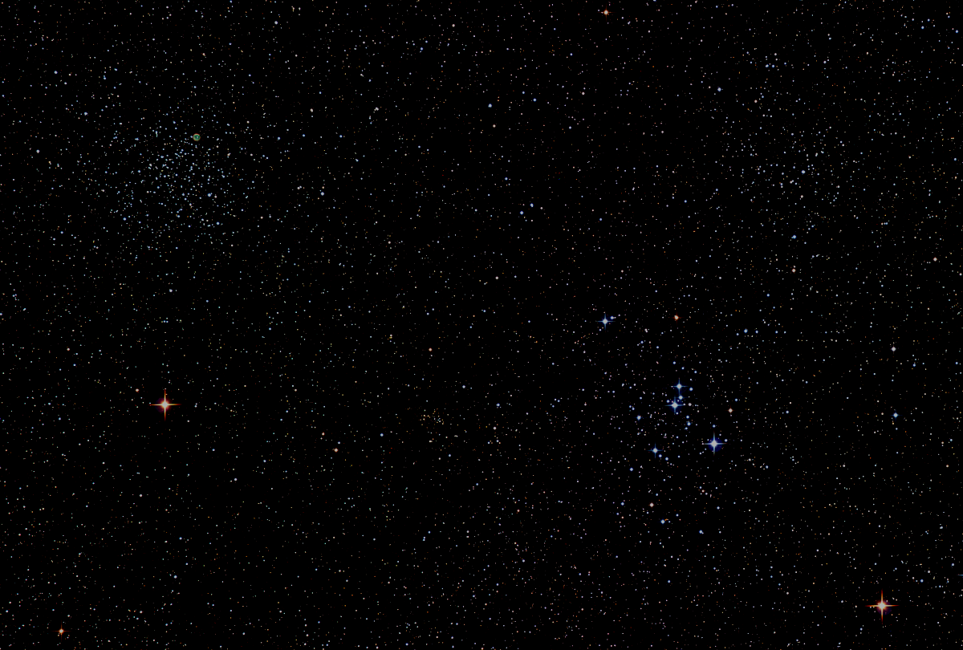

Howard
Astronomical
League
17
April 20th, 2017

Slide 2
Introductions
Observing Preferences
- Visual, photographic, other
- Object class (solar, lunar, planetary, DSO, etc…)

Slide 3
HAL Social Media
Website:
http://www.howardastro.org
Facebook:
https://www.facebook.com/groups/howardastro/
Yahoo Group (mailing list):
https://tech.groups.yahoo.com/group/howardastro/
Notes:
Mention the HAL Yahoo group has over 400 members, and the Facebook group has 282 members. Obviously, not all of those folks are HAL members, but they are all astronomy enthusiasts

Slide 4
Upcoming Events
April 20th
10am – Greenfest, HCC
8pm – Members’ Star Party, Alpha Ridge
April 27-30 – Star Gaze 23, Laurel, DE
May 6th at 8pm – Public Star Party, Alpha Ridge

Slide 5
Guest Speaker
Dr. Adam Szabo
Chief, NASA Goddard Space Flight Center
Heliospheric Phyics Laboratory
Earth and Solar Wind Science Observations of the DSCOVR Mission
Notes:
Brief Bio
After a short post-doctoral position at MIT (1993-1994), Dr. Szabo accepted a National Research Council (NRC) Research Associate position at the NASA/Goddard Space Flight Center (1994-1996). After the conclusion of the NRC fellowship, Dr. Szabo became a Hughes STX principal scientist contracted to GSFC until February 1998 when he was appointed a NASA civil service astrophysicist at the GSFC. Dr. Szabo is a member of the American Geophysical Union and has refereed for several journals. He has authored or co-authored over 90 scientific papers. Dr. Szabo specializes in heliospheric and magnetospheric shocks and discontinuities. His work includes the extension of the MHD "Rankine-Hugoniot" shock jump condition fitting technique. He has extensively analyzed the Earth, Uranus, and Neptune bow shocks. Dr. Szabo has also investigated the structure of the heliospheric current sheet and its evolution from the Sun. Recently, he has also investigated some aspects of interplanetary magnetic clouds and medium scale (10 days - 10 years) variations of magnetofluid parameters in the interplanetary medium. He has extensive experience analyzing and interpreting plasma and magnetic field data from the Voyagers, IMP 8, and WIND spacecraft. He is the data manager for the magnetic field investigation of WIND, serves as the Living With a Star Sentinels Study Scientist and leads the distributed data environment Virtual Heliospheric Observatory consortium.
Education
B.A. (Physics and Applied Mathematics) The University of Chicago, May 1988 Ph.D. (Physics) MIT, August, 1993; Thesis: Solar wind flow around Uranus and Neptune
Publications
Astrophysical Journal
Journal of Gophysical Research
Space Weather

Slide 6
Member’s astrophotos
and sketches

Slide 7
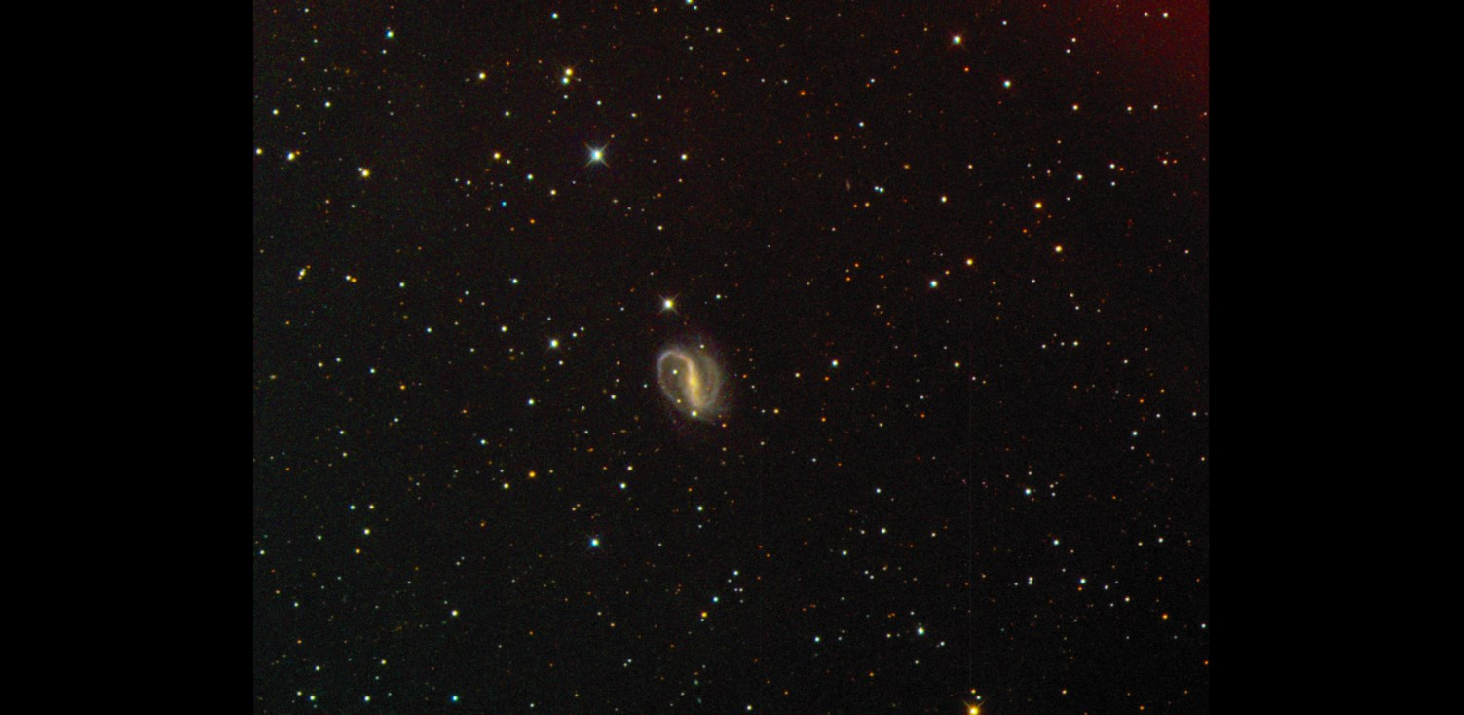
Chuck Cynamon - First deep sky photo
NGC 7479, October 30, 2016
Notes:
Chuck Cynamon – First deep sky photo!
Kitt Peak overnight observing program on Oct 30, 2016
This is NGC 7479 (aka C44). Light was collected by 10” GSO on an astrophysics 1200 mount (located in Durango, CO). The weather condition in Tucson were cloudy and windy and thus preventing us from using the 20” reflector as we had planned. My Instructor, Dean Salman, had me remotely control one of his two scopes in CO. We used a QSI 583 CCD to collect 600 second LRGB exposures which we were stacked using CCD stack to produce this image.

Slide 8
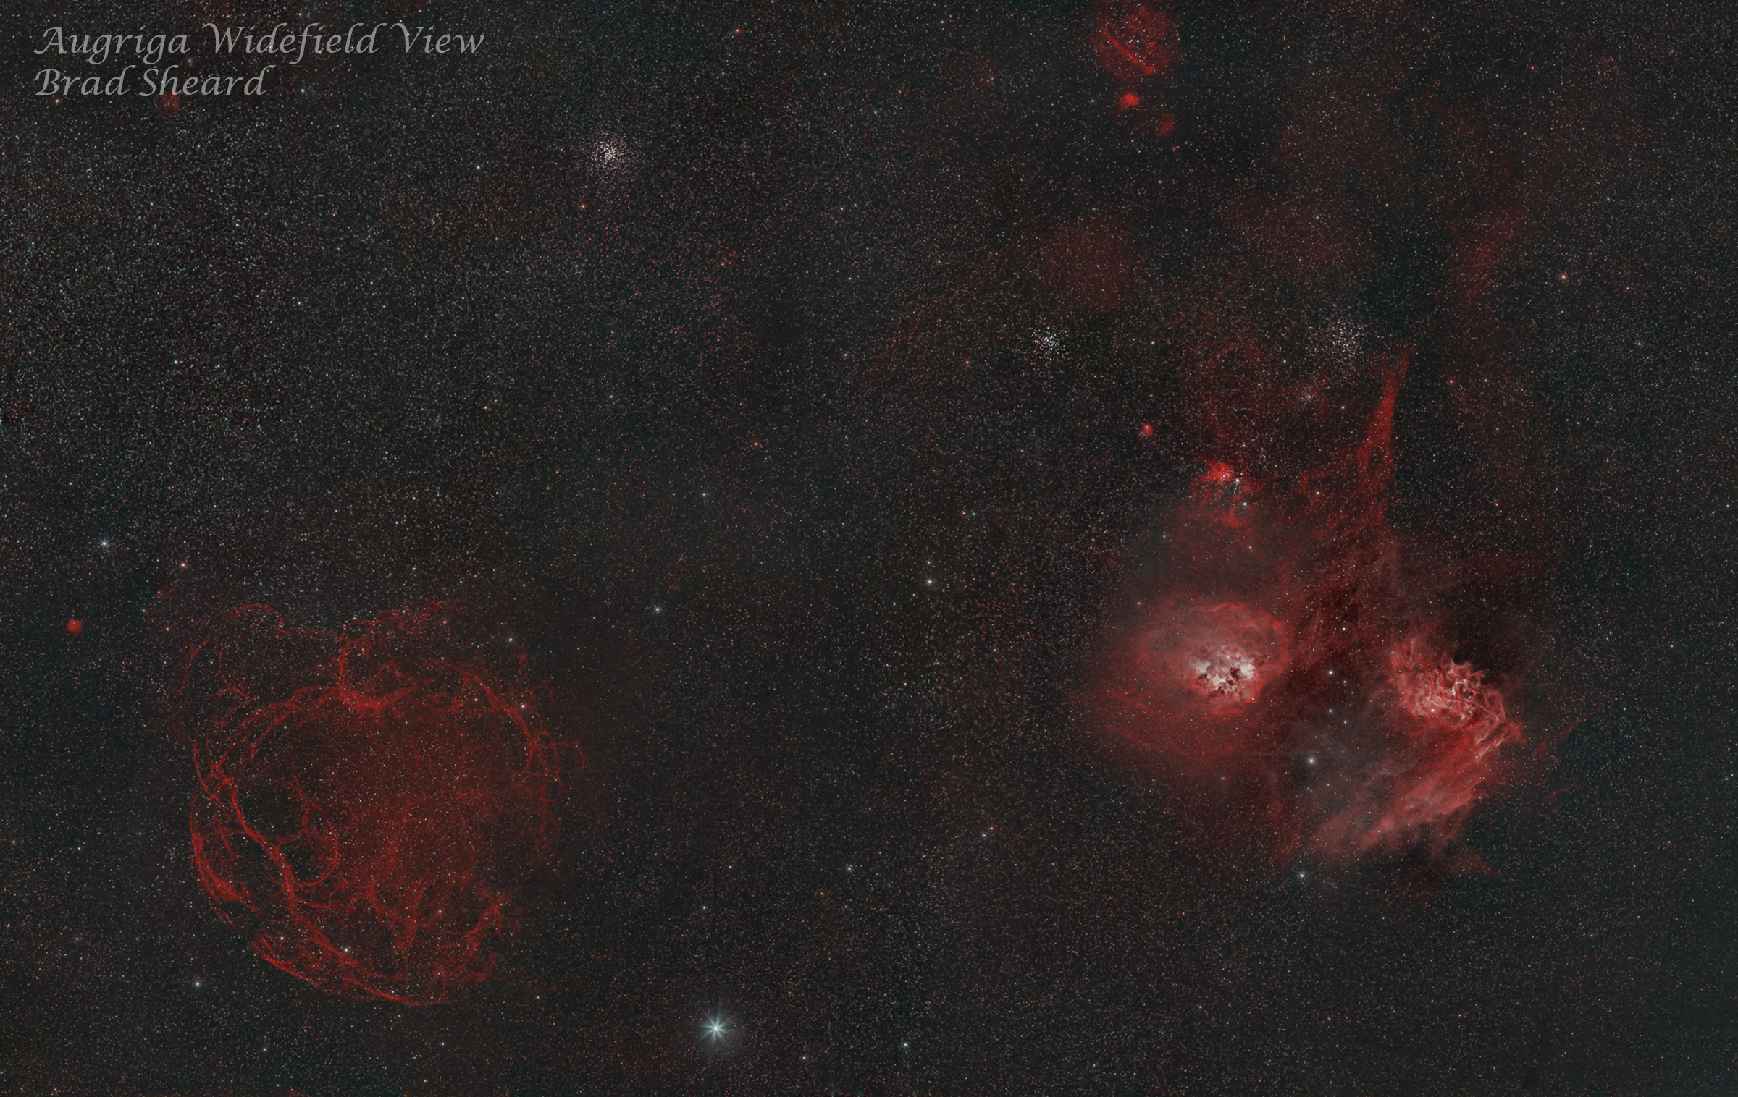
Notes:
Wide field view of a section of the constellation Auriga. It is a multi-panel mosaic that I spend most of February and March working on.
It includes the open clusters M36, M37 & M38, as well as the Flaming Star Nebula and the supernova remnant Sharpless 2-240.

Slide 9
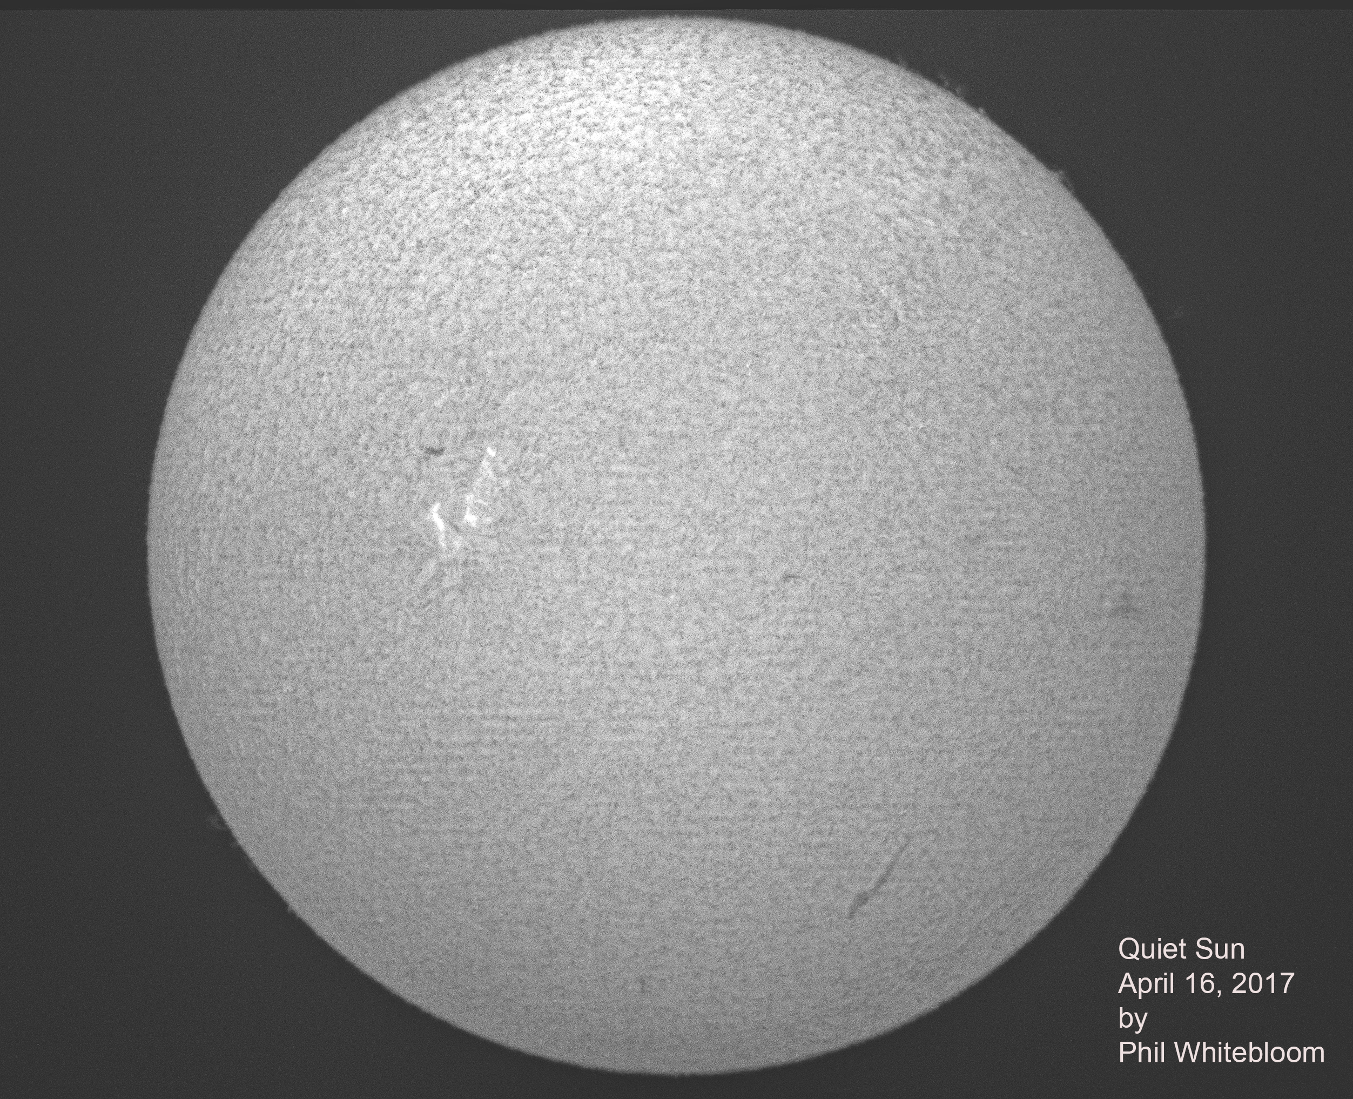
Notes:
This is the first picture that I have done with my new ZWO monochrome camera. Also, it is the first time that I have used FireCapture software. It came out pretty well. I did use RegiStax 6, Photoshop, and Lightroom for post processing.

Slide 10
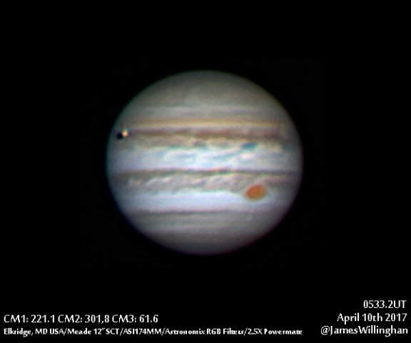
Notes:
Io crossing Jupiter about 3 days past opposition. Note shadow.

Slide 11
Night Sky Summary
Sun now rises at 6:23am and sets at 7:50pm
Moon: |⚪Apr 26|◑ May 3|⚫May 10| ◐ May 19| Best earthshine view is around Apr 29.
Planets: Venus is just beginning a morning apparition, rising about an hour before sunrise. It appears as a waxing crescent, increasing in apparent size. Find Mars continuing to hang on in the western sky after sunset. Jupiter reached opposition on April 7th, and is quickly becoming more favorably placed for evening viewing. Saturn is a morning object rising shortly at around midnight headed toward opposition in June.
Constellations: Cancer, Leo, and Ursa Major are near the zenith at sunset.

Slide 12
Thank You!
Next month’s meeting is on Thursday, May 18th, 2017 7 PM
Louis Mayo
August 2017 Solar Eclipse:
Science Expectations
Notes:
Lou Mayo has over 20 years experience in program management, supporting NASA and NOAA including over 10 years managing efforts for the NASA National Space Science Data Center and the Space Physics Data Facility. He has over 20 years experience in planetary research working on special problems concerning planetary atmospheres. He served for 11 years on the Voyager IRIS and Cassini CIRS teams. He has over 15 years experience developing and implementing space science education programs on both regional and national levels and is a professor of astronomy at Marymount University and member of the DC Space Grant Consortium. He has authored numerous articles on astronomy and astronomy education and is a frequent speaker on space science and astronomy for the public.

